Slide 1
Budgetary Affairs Committee
Nov 19, 2020
Referrals
Revisit tuition discount rate
Continuing referrals:
Report on the “big picture balance sheet”
Current and next FY budget

Slide 2
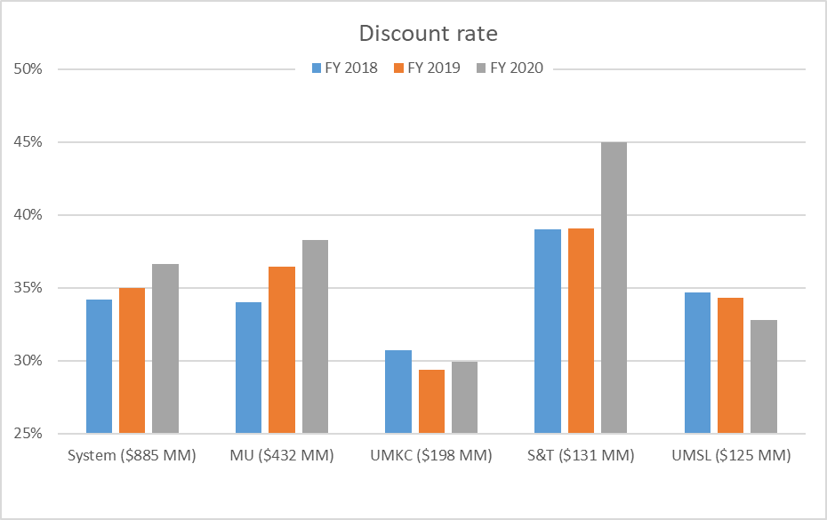
Tuition discount rate comparison
Proportionally more students receive
Merit-based scholarships
Need-based scholarships
Financial aid strategies: developed by Enrollment Mgt with assistance from consultants, CFO/Provost/Chancellor review and approve.
Internal discount in red; MU = 26% FY20, S&T = 30%
Data: Budget Book, UM System 2020 Budget
Uses different ‘all funds’ than past slides

Slide 3
All Funds Budget: revenue
$8 MM accounting change nets zero, but
$4 MM increase in scholarship costs
 | FY19 | FY20 | FY21 (budgeted)
Tuition and Fees | $134,602,696 | $130,456,684 | $123,806,127
Scholarship Allowance | (52,410,261) | (64,966,612) | (62,236,470)
Net Tuition & Fees | $82,192,434 | $65,490,072 | $61,569,657
State Appropriation | 50,185,510 | 43,543,499 | 43,560,524
Grant and Contract | 40,338,895 | 48,105,314 | 48,902,000
Gift Revenues | 7,522,979 | 3,031,199 | 6,164,295
Recovery of F & A | 14,039 | 430 | 0
Endowment & Investment Income | 9,326,040 | 9,604,262 | 9,082,208
Sales & Services Income | 21,769,025 | 17,634,555 | 19,141,165
Other Incomes | 4,619,518 | 8,414,083 | 4,497,816
Revenue Contingency | - | - | (938,512)
Total Revenues | $215,968,442 | $195,823,416 | $191,979,152
$6.6 MM drop
$2.7 MM lower cost
Fear of withholding
$1.5 MM rebound estimated
Internal withhold
$3.85 MM cut
$11.7 MM cut planned,
where’s $7.85 MM?
$4 MM decrease = sent home (dorms, dining)

Slide 4
General Revenue Budget
Change: includes distance tuition, $1-2 MM, so at least $7 MM decline
$58,280,686 of budget is not general revenue
 | FY19 | FY20 | FY21 (budgeted)
Tuition and Fees | $124,548,154 | $126,853,439 | $120,891,674
Scholarship Allowance | (37,770,678) | (37,848,888) | (42,105,102)
Net Tuition & Fees | $86,777,476 | $89,004,551 | $78,786,571
State Appropriation | 50,185,510 | 43,543,499 | 43,560,524
Grant and Contract | 0 | 0 | 0
Gift Revenues | 481,131 | 385,737 | 317,500
Recovery of F & A | 6,941,286 | 6,802,499 | 6,099,000
Endowment & Investment Income | 1,969,324 | 2,035,737 | 1,496,386
Sales & Services Income | 989,382 | 1,177,479 | 1,093,340
Other Incomes | 3,464,299 | 2,872,553 | 3,283,657
Revenue Contingency | - | - | (938,512)
Total Revenues | $150,808,407 | $145,822,055 | $133,698,466
$4.2 MM = 11% increase vs previous year
30%
30%
35%
More withholding not expected
(G&C are dedicated, not GRA)
F&A above budgeted so far;
F&A ~ 4.6% of revenue
(Investments and gift “tax”)
(Havener rental fees, not dorms)
Always $1MM contingency, System changed accounting location
$12.1 MM lower than FY20, Tuition + Increased scholarships ≥ $11.2 MM

Slide 5
GRA cut > All funds cut
All funds includes capital gifts and changes in market value of investments, non-spendable.
 |  |  | FY21
Tuition and Fees |  |  | $688,792
Scholarship Allowance |  |  | (6,986,356)
Net Tuition & Fees |  |  | ($6,297,565)
State Appropriation |  |  | 0
Grant and Contract |  |  | (796,686)
Gift Revenues |  |  | (3,201,333)
Recovery of F & A |  |  | (703,069)
Endowment & Investment Income |  |  | (17,297)
Sales & Services Income |  |  | (1,590,749)
Other Incomes |  |  | 4,327,371
Revenue Contingency |  |  | 0
Total Revenues |  |  | ($8,279,325)
All funds shows cost is less by $2.7 MM, GRA shows more by $4.2 MM
Rise in gifts, but dedicated spend

Slide 6
All Funds Budget: costs
Total Revenues | $215,968,442 | $195,823,416 | $191,979,152
Transfers | FY19 | FY20 | FY21 (budgeted)
Intra Unrestricted CurrentFund | $968,016 | $4,220,348 | $106,060
Mandatory Transfers | (10,718,936) | (11,384,016) | (11,559,318)
NonMandatory Transfers | (14,361,580) | (10,630,586) | (413,847)
Total Transfers | ($24,112,501) | ($17,794,253) | ($11,867,106)
Expenditures
Salaries & Wages | $106,061,187 | $102,581,750 | $99,824,540
Benefit Expense | 30,532,226 | 30,384,639 | 32,000,257
Compensation | $136,593,413 | $132,966,389 | $131,824,796
Other_Expenses | 57,209,262 | 47,944,226 | 47,340,424
Total Expenditures | $193,802,675 | $180,910,615 | $179,165,220
Total Expenditures + Transfers | $217,915,176 | $198,704,868 | $191,032,326
Paying loans on dorms, geothermal, Bertelsmeyer
$2.76 MM cut
Benefit cost growth, layoff costs
$0.94 MM ‘withhold’

Slide 7
General Revenue Budget: costs
Total Revenues | $150,808,407 | $145,822,055 | $133,698,466
Distance moved from here to tuition + “movement between campuses”
Transfers | FY19 | FY20 | FY21 (budgeted)
Intra Unrestricted CurrentFund | $6,755,777 | $4,442,960 | $195,883
Mandatory Transfers | (3,778,102) | (3,930,896) | (3,612,726)
NonMandatory Transfers | (11,607,554) | (6,885,979) | 1,509,153
Total Transfers | ($8,629,879) | ($6,373,915) | ($2,299,456)
Expenditures
Salaries & Wages | $83,651,987 | $80,232,396 | $77,824,286
Benefit Expense | 25,475,433 | 25,029,887 | 26,311,435
Compensation | $109,127,420 | $105,262,283 | $104,135,721
Other_Expenses | 38,416,204 | 33,205,855 | 27,882,045
Total Expenditures | $147,543,624 | $138,468,138 | $132,017,766
Paying loans on dorms, geothermal, Bertelsmeyer
$2.41 MM cut
$1.28 MM Benefit growth, layoffs
$6.45 MM spending decrease

